Slide 1
Computer Engineering 12 Class 16
Instructor: Yuhong Liu
Office: Bannan 324 F
Email: yhliu@scu.edu
Tel: 408-551-3513

Slide 2
2nd Mid-term Exam
Date: Feb. 21st, 2018 (Wednesday)
Content: Everything after 1st midterm through Friday (02/16/2018)
Linear List:
ADT: Stack & Queue
Implemented by array and linked List
Nonlinear list:
Tree: General tree; Binary tree; Binary Search Tree, AVL Tree

Slide 3
BST - Traversal
Preorder: <on example tree ...>
Self, Left, Right (SLR)
Postorder: <again, on example ...>
Left, Right, Self (LRS)
How about Left, Self, Right (LSR)?
<...>
“Inorder” traversal

Slide 4
BST - Traversal
17
void inorder(NODE *np) {
if (np == NULL)
return;
inorder(np->left);
//printf now in middle
printf(“%d\n”,np->data);
inorder(np->right);
}
6
19
3
14
22
23
16

Slide 5
Iteration & Recursion
Can we do traversal through iterations instead of recursions?
Every time when you make a choice, you can only visit part of the tree. You need to return to your original decision to visit the rest part of the tree.
For iterations, once you get to the next iteration, the information in the previous iteration will be lost.
When can we use iterations?
when we don’t need to return back to the previous choice.

Slide 6
Exercise
What is the print sequence for the tree below if we do the printing in preorder, postorder and inorder?
17
6
23
3
14
20
25
1
18

Slide 7
BST- Min/Max
How to find the minimum/maximum element in a BST?
Min node is the leftmost node at the bottom level
Max node is the rightmost node at the bottom level
Can we use recursions?
Can we use iterations?
Yes
Yes

Slide 8
BST - recursive Min
Where is the minimum node in a BST? let’s find it recursively
Base case?
Recursive case?
int minimum(NODE *np) {
assert(np != NULL);
if (np->left == NULL)
return np->data;
return minimum(np->left);
}

Slide 9
Binary Search Trees - iterative Min
Can we find it through iterations?
Int minimum(NODE *np) {
assert(np != NULL);
while (np->left != NULL)
np = np->left;
return np->data;
}

Slide 10
BST - Max
<Code up maximum too as an assignment - exam hint!>

Slide 11
BST - Insertion
To insert data, we need to follow the branches to an empty subtree and then insert the new node.
All inserts take place at a leaf or at a leaflike node – a node that has only one subtree.
Example: insert 15, 13.
17
6
19
3
14
18
22

Slide 12
Exercise
Give me an arbitrary number and let’s insert it into the tree.
What’s the worst-case big O?
O(h) +O(1) = O(h)

Slide 13
Insertion Code (I)
L | 17 | R
bool insertNode(NODE** root, NODE* np)
{
assert(np!=NULL);
// Base case
if (*root == NULL)
{
*root = np;
return true;
}
// If the node to be inserted is smaller than the
//root's data, it lies in left subtree
if (np->data < (*root)->data)
return insertNode(&(*root)->left, np);
// If the node to be inserted is greater than the
//root's data, it lies in right subtree
else if (np->data > (*root)->data)
return insertNode(&(*root)->right, np);
// if x is same as root's data,
else
return false;
}
L | 10 | R
L | 20 | R
L | 5 | R
L | 12 | R
L | 19 | R
Notes:
The returned node will be connected to the tree.
The base case is when an empty tree is met.
Then how to connect the new node to the BST?

Slide 14
Insertion Code (II)
L | 17 | R
NODE* insertNode(NODE* root, NODE* np)
{
assert(np!=NULL);
// Base case
if (root == NULL)
{
return np;
}
// If the node to be inserted is smaller than the
//root's data, it lies in left subtree
if (np->data < root->data)
root->left = insertNode(root->left, np);
// If the node to be inserted is greater than the
//root's data, it lies in right subtree
else if (np->data > root->data)
root-> right = insertNode(root->right, np);
return root;
}
L | 10 | R
L | 20 | R
L | 5 | R
L | 12 | R
L | 19 | R
Notes:
The returned node will be connected to the tree.
The base case is when an empty tree is met.
Then how to connect the new node to the BST?

Slide 15
BST - Deletion
Delete node 5 or node 10
Delete node 14 or node 19
Delete node 6
17
6
19
3
14
22
23
5
10

Slide 16
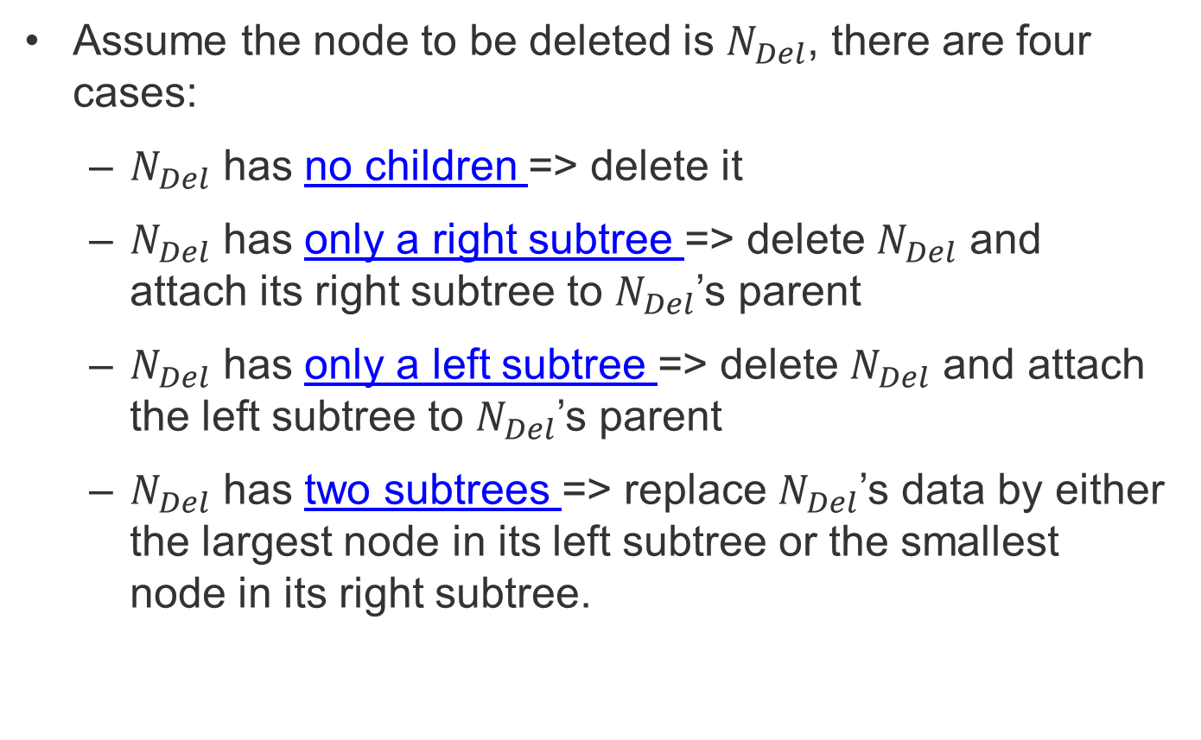
BST - Deletion
Assume the node to be deleted is $N_{Del}$, there are four cases:
$N_{Del}$ has no children => delete it
$N_{Del}$ has only a right subtree => delete $N_{Del}$ and attach its right subtree to $N_{Del}$’s parent
$N_{Del}$ has only a left subtree => delete $N_{Del}$ and attach the left subtree to $N_{Del}$’s parent
$N_{Del}$ has two subtrees => replace $N_{Del}$’s data by either the largest node in its left subtree or the smallest node in its right subtree.

